Slide 1
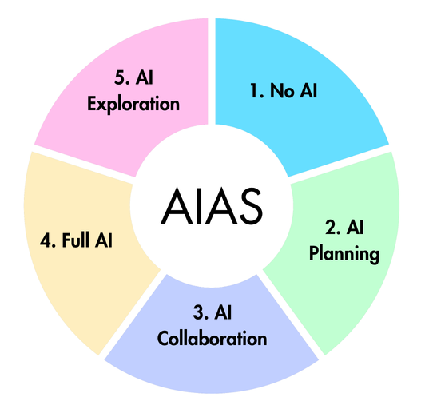

The AI Assessment Scale (AIAS)
AIAS v2.1 Design Assets
1 | NO AI | This task is completed in a controlled environment designed to exclude AI. Knowledge, understanding, and skills are demonstrated and assessed independently.
2 | AI PLANNING | This task focuses on planning activities such as topic exploration, outlining, and initial research. AI may be used to support this process, and the quality of planning and idea development is assessed whether or not AI was used.
3 | AI COLLABORATION | AI may be used to help complete this task, including idea generation, drafting, feedback, and refinement. It is designed so that AI alone will not reach the required standard. Assessment covers both the work itself and how AI outputs are evaluated, modified, and integrated.
4 | FULL AI | There is an expectation of AI involvement in this task. The goal cannot be reached by AI or by a person working alone in the time available. Assessment focuses on the critical thinking and subject knowledge shown in directing AI.
5 | AI EXPLORATION | This task is designed for creative AI use to solve problems, generate novel insights, or develop innovative solutions in the discipline. Approaches may be co-designed by students and instructors.
AI Assessment Scale (AIAS) v2.1 © 2026 Learning Innovation Practice Ltd. Based on the original AIAS by Perkins, Furze, Roe & MacVaugh.

Slide 2
About This Document
This document contains editable design assets for the AI Assessment Scale (AIAS) v2.1 (2026). We are releasing this version of the AI Assessment Scale under a CC BY NC SA 4.0 license, which means you are free to:
  Share: Copy and redistribute the material in any medium or format.
  Adapt: Remix, transform, and build upon the material.
Under the following terms:
  Attribution (BY): You must give appropriate credit, provide a link to the license, and indicate if changes were made. You may do so in any reasonable manner, but not in any way that suggests the licensor endorses you or your use.
  NonCommercial (NC): You may not use the material for commercial purposes. For commercial use, please visit learninginnovationpractice.com or email hello@lip.education.
  ShareAlike (SA): If you remix, transform, or build upon the material, you must distribute your contributions under the same license as the original.
No additional restrictions: You may not apply legal terms or technological measures that legally restrict others from doing anything the license permits.
For further details, please refer to the full license text at https://creativecommons.org/licenses/by-nc-sa/4.0/

Slide 3
#64DEFF
AIAS Colours and Fonts
If you’re not adapting the AIAS with your own colours, these are our choices. We also use the Futura font in various sizes, with bold font on the circle, diagrams and titles.
#C1FFD2
#C1CFFF
#FFF1C1
#FFC1EE

Slide 4

1 | NO AI | This task is completed in a controlled environment designed to exclude AI. Knowledge, understanding, and skills are demonstrated and assessed independently.
2 | AI PLANNING | This task focuses on planning activities such as topic exploration, outlining, and initial research. AI may be used to support this process, and the quality of planning and idea development is assessed whether or not AI was used.
3 | AI COLLABORATION | AI may be used to help complete this task, including idea generation, drafting, feedback, and refinement. It is designed so that AI alone will not reach the required standard. Assessment covers both the work itself and how AI outputs are evaluated, modified, and integrated.
4 | FULL AI | There is an expectation of AI involvement in this task. The goal cannot be reached by AI or by a person working alone in the time available. Assessment focuses on the critical thinking and subject knowledge shown in directing AI.
5 | AI EXPLORATION | This task is designed for creative AI use to solve problems, generate novel insights, or develop innovative solutions in the discipline. Approaches may be co-designed by students and instructors.
AI Assessment Scale (AIAS) v2.1 © 2026 Learning Innovation Practice Ltd. Based on the original AIAS by Perkins, Furze, Roe & MacVaugh.

Slide 5
The AI Assessment Scale (AIAS)
v2.1
1 | NO AI | This task is completed in a controlled environment designed to exclude AI. Knowledge, understanding, and skills are demonstrated and assessed independently.
2 | AI PLANNING | This task focuses on planning activities such as topic exploration, outlining, and initial research. AI may be used to support this process, and the quality of planning and idea development is assessed whether or not AI was used.
3 | AI COLLABORATION | AI may be used to help complete this task, including idea generation, drafting, feedback, and refinement. It is designed so that AI alone will not reach the required standard. Assessment covers both the work itself and how AI outputs are evaluated, modified, and integrated.
4 | FULL AI | There is an expectation of AI involvement in this task. The goal cannot be reached by AI or by a person working alone in the time available. Assessment focuses on the critical thinking and subject knowledge shown in directing AI.
5 | AI EXPLORATION | This task is designed for creative AI use to solve problems, generate novel insights, or develop innovative solutions in the discipline. Approaches may be co-designed by students and instructors.
AI Assessment Scale (AIAS) v2.1 © 2026 Learning Innovation Practice Ltd. Based on the original AIAS by Perkins, Furze, Roe & MacVaugh.

Slide 6

5. AI Exploration
1. No AI
AIAS
AIAS
2. AI Planning
4. Full AI
3. AI Collaboration
AI Assessment Scale (AIAS) v2.1 © 2026 Learning Innovation Practice Ltd. Based on the original AIAS by Perkins, Furze, Roe & MacVaugh.

Slide 7
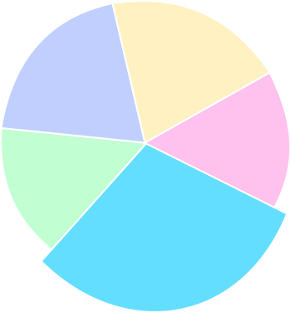
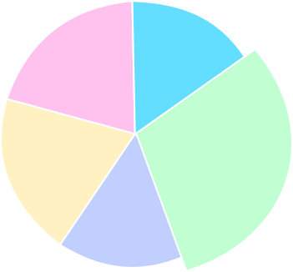
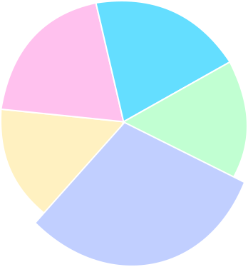
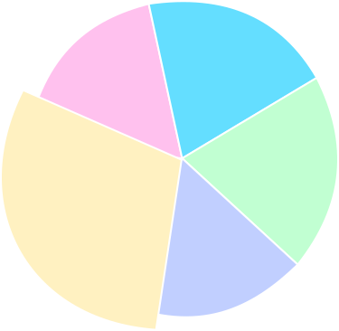
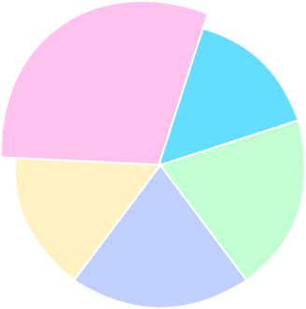

5. AI Exploration
1. No AI
Designed for creative, exploratory AI use
2. AI Planning
AIAS
AIAS
AIAS
AIAS
Completed under secure, controlled conditions
AIAS
4. Full AI
AIAS
AIAS
Designed for planning, idea development, and research
Designed for AI use throughout the task
3. AI Collaboration
Designed for drafting, refining, and evaluating with AI
AI Assessment Scale (AIAS) v2.1 © 2026 Learning Innovation Practice Ltd. Based on the original AIAS by Perkins, Furze, Roe & MacVaugh.

Slide 8
1. No AI
Completed in a controlled environment designed to exclude AI. Knowledge and skills are demonstrated independently.
AIAS

Slide 9
2. AI Planning
AIAS
Focused on topic exploration, outlining, and research. Planning quality is assessed whether or not AI was used.

Slide 10
AIAS
3. AI Collaboration
Designed for drafting, refining, and evaluating with AI

Slide 11
AIAS
AIAS
4. Full AI
Designed for AI use throughout the task

Slide 12
5. AI Exploration
Designed for creative, exploratory AI use
AIAS
AIAS

